Slide 1
Document Databases
Wes McClure
https://bitbucket.org/wes_mcclure/docdbplayground

Slide 2
?

Slide 3
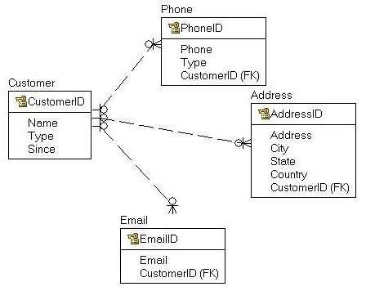
What is a Doc DB?
Document based
Semi-structured storage
That’s it!

Slide 4
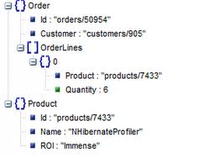
Doc DB explained
JSON/XML interface
Consistent structure
Flexible schema
Index-able Key/Value store

Slide 5
Misconceptions
Intra join
Inter join
Not ACID
Joins
Intra document
Inter document / system
Mongo – DBReference
Raven -
NoSQL
Javascript instead

Slide 6
Uses – Logging

Slide 7
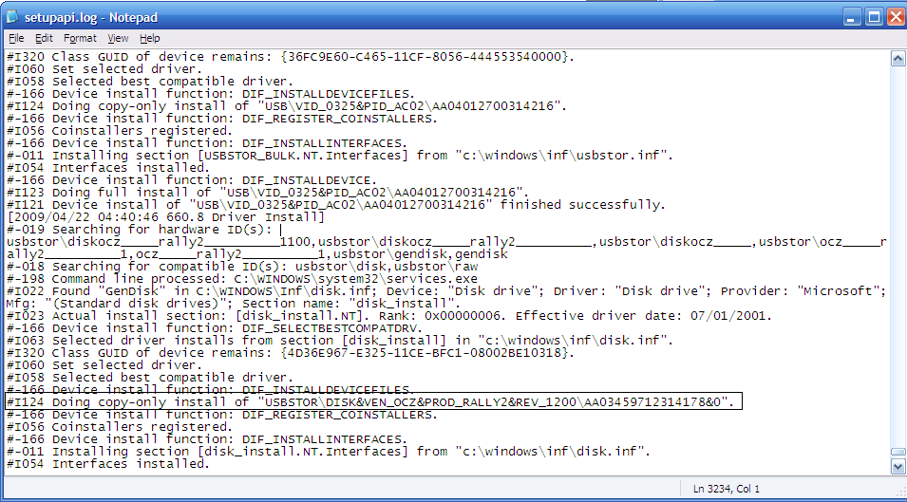
Logging
Lots of message types
Inconsistently serialized to strings
Logging metadata
Ad hoc queries

Slide 8
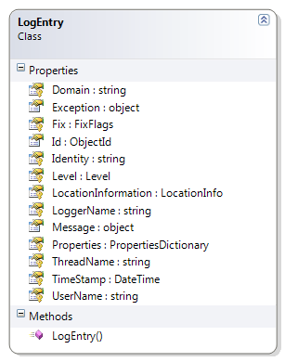
Structure
Flexible Schema

Slide 9
Logging - Justification
Flat files
Hard to query
Inconsistent string serialization
RDBMS
Hard to query (flexible schema)
Hard to serialize (flexible schema)
Doc DBs
No friction!
Ad hoc queries
Flexible storage

Slide 10
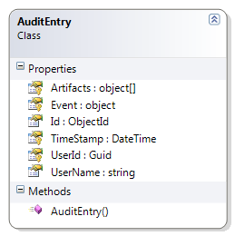
Auditing
Why not?

Slide 11
Uses - COnfiguration

Slide 12
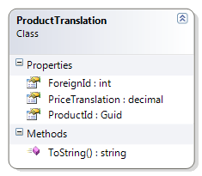
Config Data
Properties
Not queried
Not joined
All or One typically
XML – Bleh
RDBMS – Bleh

Slide 13
Configuration - Justification
Config files
Inconsistent serialization
Maintenance
RDBMS
Friction (schema/mapping)
No relationships
Doc DB
No friction

Slide 14
Uses – ADHOC Data

Slide 15
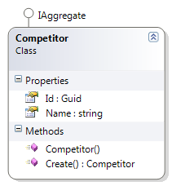
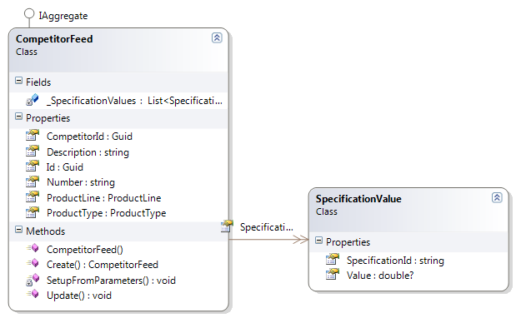
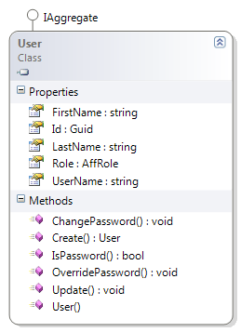
ADHOC Data
Small sets
Sub-collections
Schemas? Mappings? SQL?
Just .Save it!

Slide 16
DDD Aggregates

Slide 17
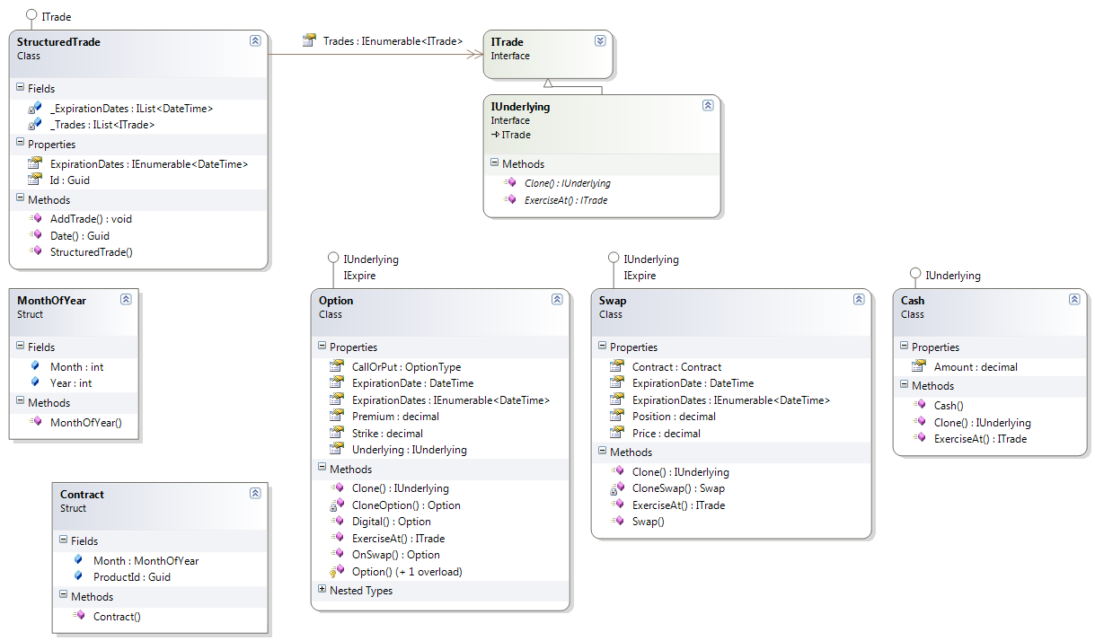
DDD – Aggregates

Slide 18
Why?
Aggregate Model
Focus on problem at hand
Individual write/read model
Advanced modeling
Leads to simplification
Avoid association soup
Consistency within
Encapsulation
No references to internals
Collection level querying
Map/Reduce

Slide 19
Why not RDBMS?
Good luck w/ RDBMS
Wasted many hours
RDBMS serialization bleeds into code even with good ORMs
Nested collections don’t have identifier concepts needed for SQL (encapsulation)

Slide 20
Tools

Slide 21
Mongo Setup
MongoDB Service (installer)
http://www.mongodb.org/downloads
Norm .Net Client
https://github.com/atheken/NoRM
RockMongo (php) web UI
http://code.google.com/p/rock-php/wiki/rock_mongo

Slide 22
Couch Setup
http://couchdb.apache.org/
CouchDB Service (installer)
http://wiki.apache.org/couchdb/Windows_binary_installer
Hammock .Net Client
http://code.google.com/p/relax-net/
Others
http://wiki.apache.org/couchdb/Getting_started_with_C%23
Divan
Relax
Built-in Futon Web UI
http://localhost:5984/_utils/

Slide 23
RavenDB Setup
http://ravendb.net/download
Builtin
Service w/ installer
Web UI
.Net LINQ API

Slide 24
Feature Comparisons
 | MongoDB | CouchDB | RavenDB
Format | BSON | JSON | JSON
Metadata | No | System | System + Custom
Versioning | No | Yes | Yes
Map/Reduce syntax | Javascript | Javascript | LINQ
Adhoc query | Built for it! | No | Just released
Transactions |  |  | Yes
Concurrency |  | MVCC | Optimistic – check at end
Interface | Custom TCP/IP | HTTP | HTTP
Common Features | Sharding, Replication, Attachments, Import/Export
http://www.slideshare.net/brianritchie1/document-databases-ravendb

Slide 25
Questions?

